Slide 1

TPCS Native Forest Restoration
28 July 2025
Galatians 6:7-10

Slide 2




Slide 3
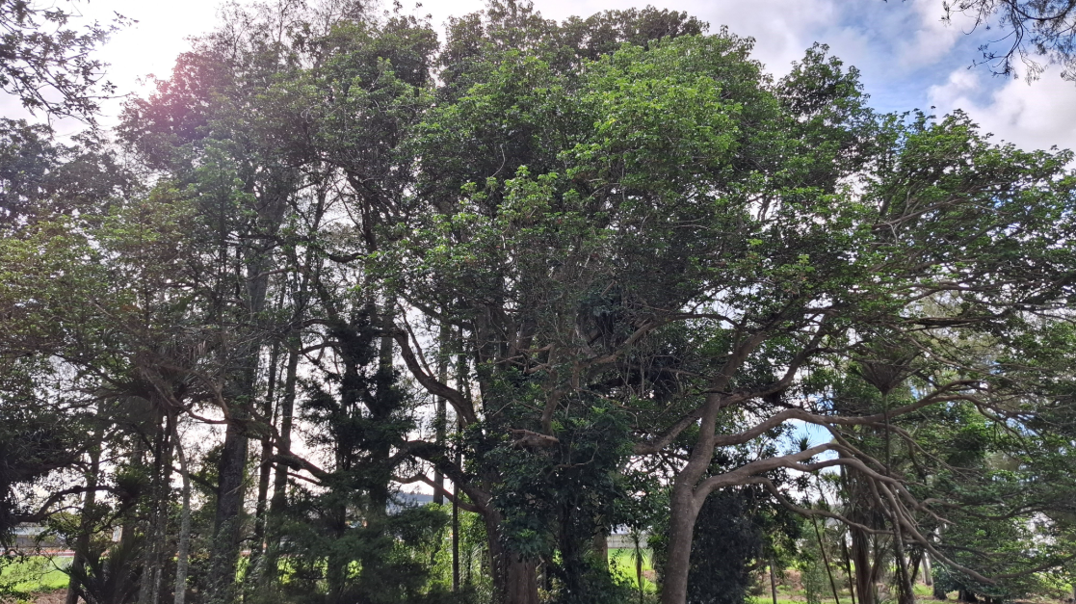


Slide 4
Galatians 6:7-8
Be not deceived; God is not mocked: for whatsoever a man soweth, that shall he also reap.​
For he that soweth to his flesh shall of the flesh reap corruption; but he that soweth to the Spirit shall of the Spirit reap life everlasting.​

Slide 5
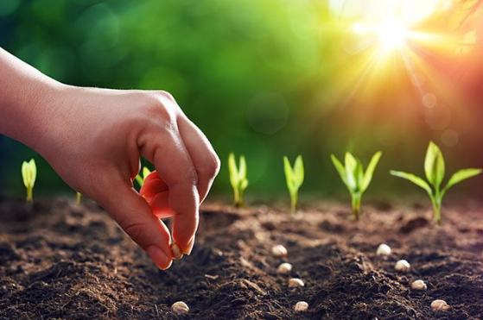
Sowing and Reaping

Slide 6

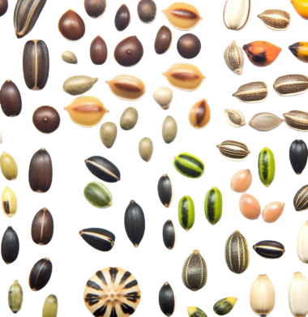
What type of seeds are you sowing in your life?

Slide 7


Slide 8
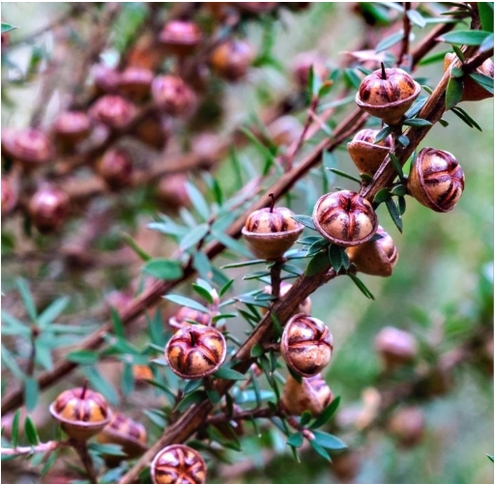
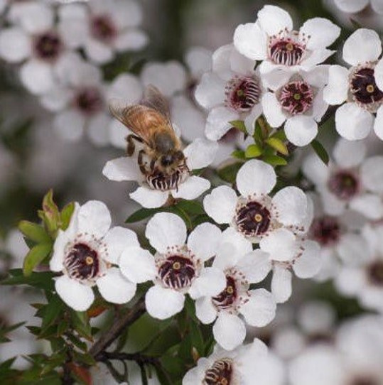

Slide 9
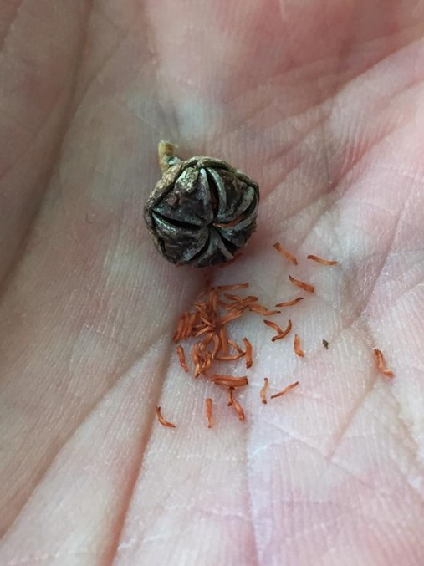
Manuka
Seeds

Slide 10
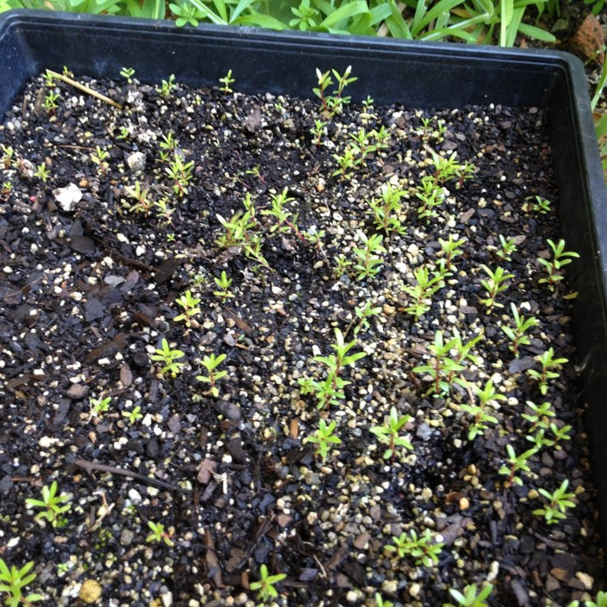

Manuka
Seedlings

Slide 11
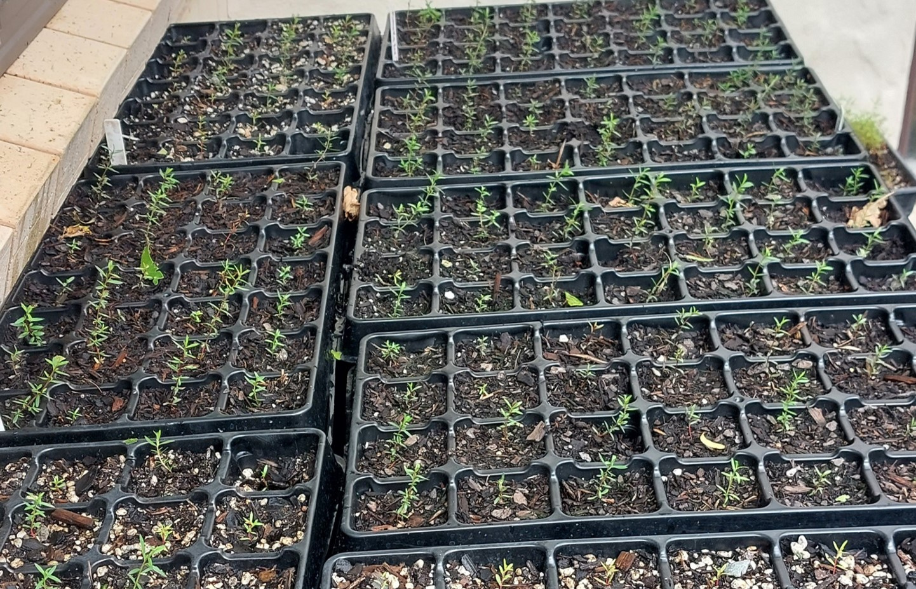

Slide 12

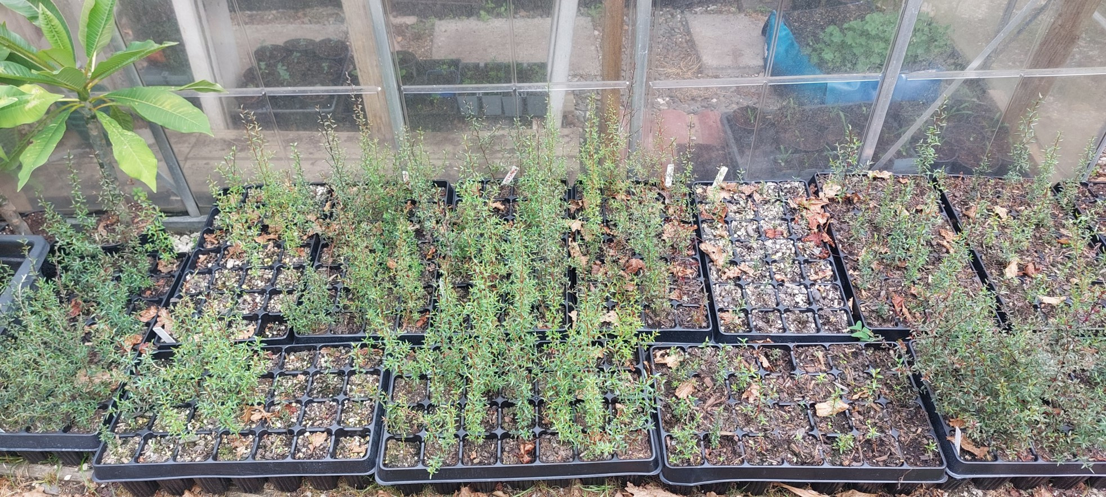
Growing Manuka

Slide 13

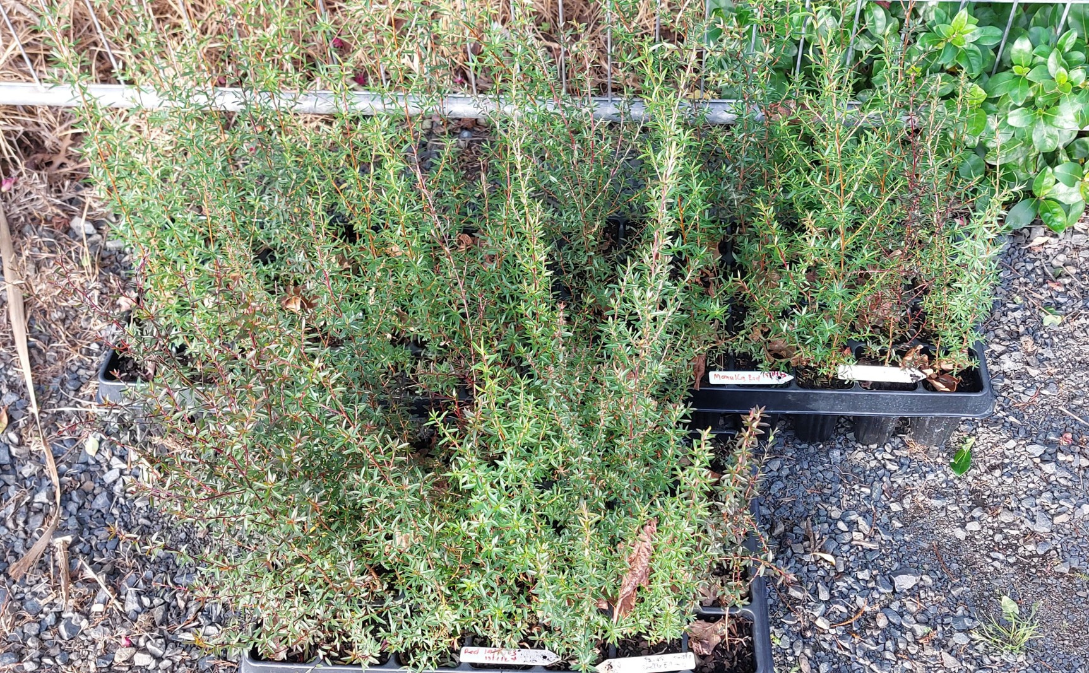


Ready to plant!

Slide 14

Galatians 6:9
And let us not be weary in well doing: for in due season we shall reap, if we faint not.

Slide 15

Seasons

Slide 16


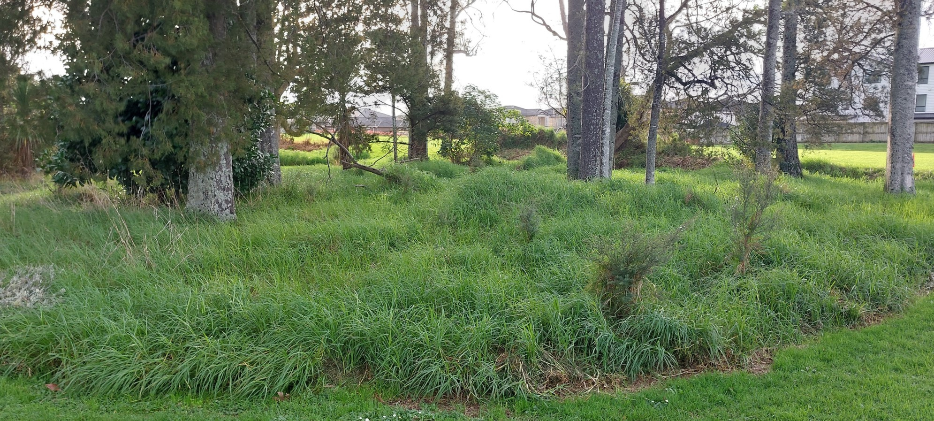



Slide 17
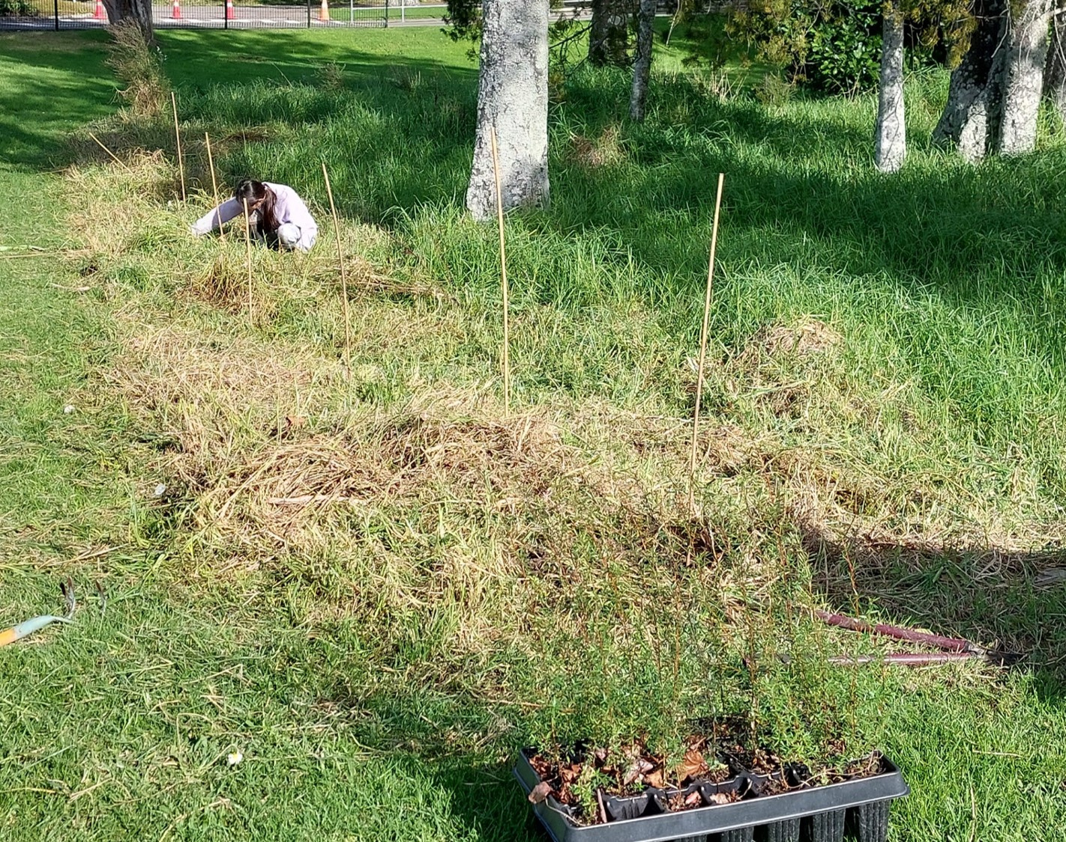
Planting in the weeds is hard

Slide 18
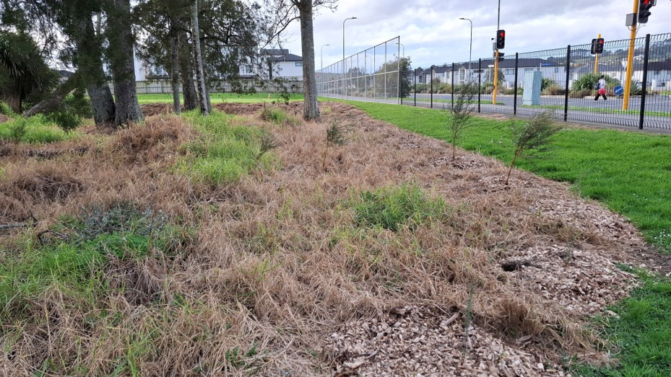

Slide 19
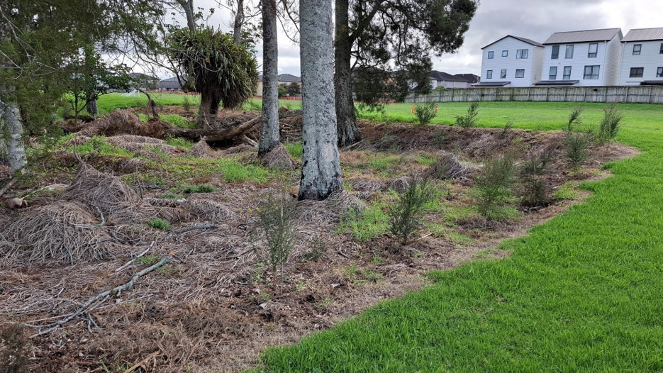

Slide 20
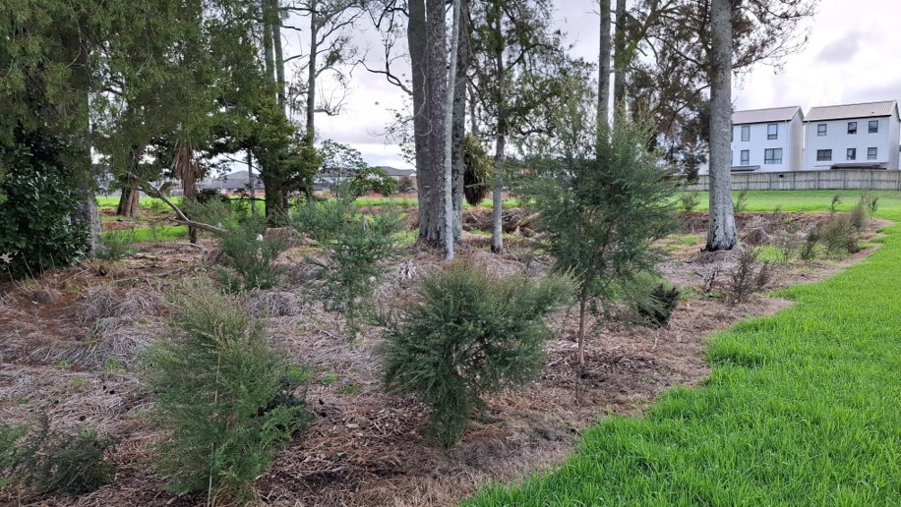

Slide 21
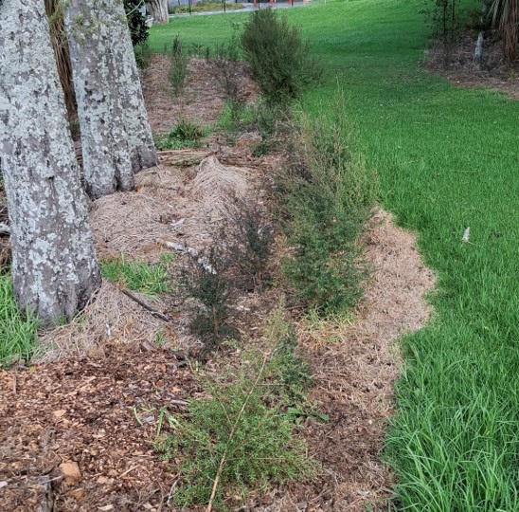


Slide 22
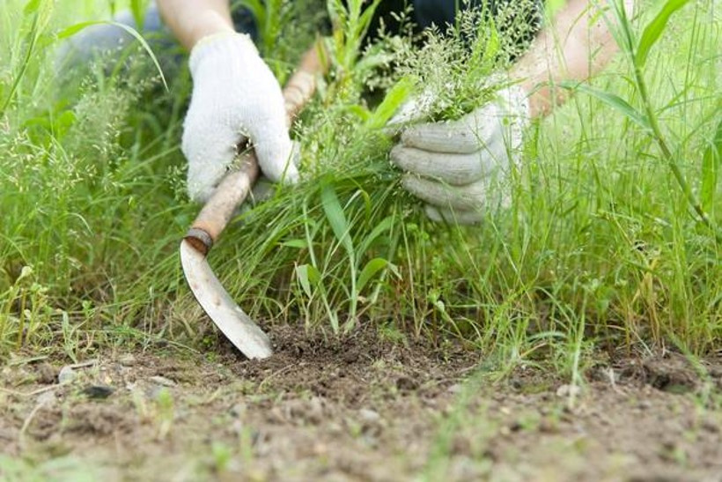
Remove the weeds in your life

Slide 23
Galatians 6:9
And let us not be weary in well doing: for in due season we shall reap, if we faint not.

Slide 24
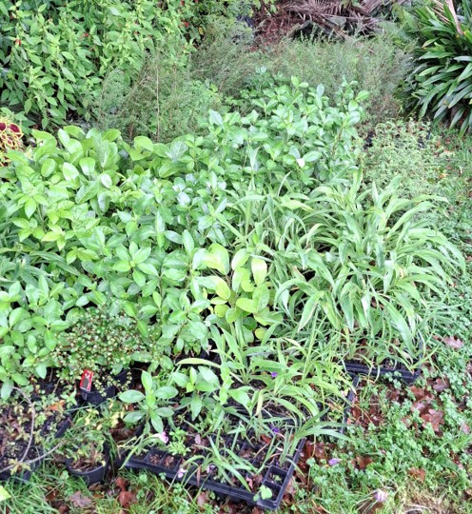
Our native plant nursery

Slide 25
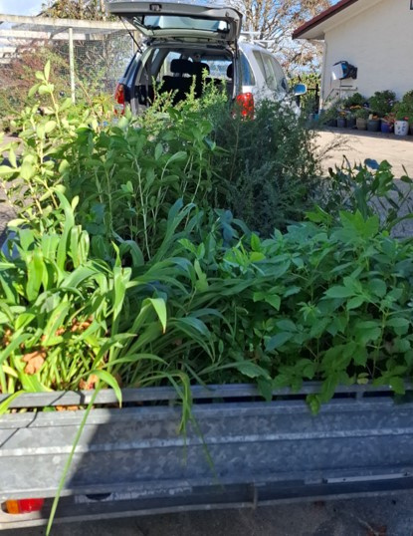
Bring plants to school

Slide 26
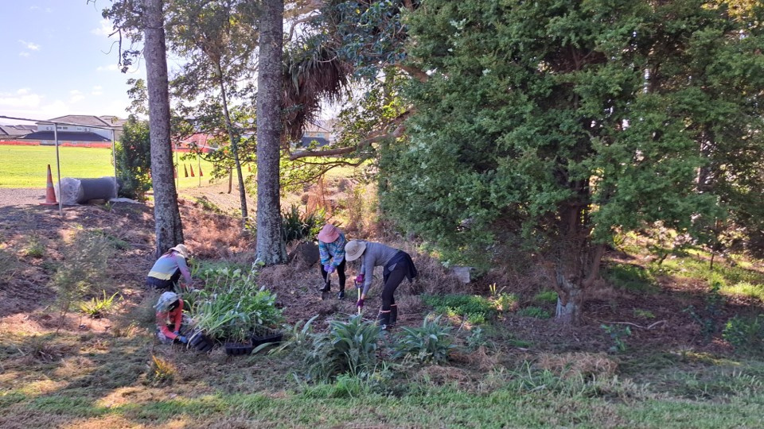
Hard Work

Slide 27
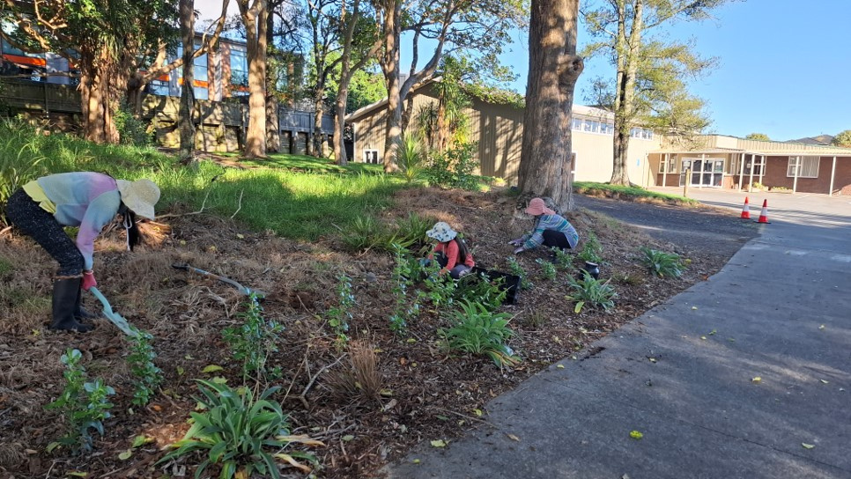


Slide 28
Galatians 6:9
And let us not be weary in well doing: for in due season we shall reap, if we faint not.

Slide 29
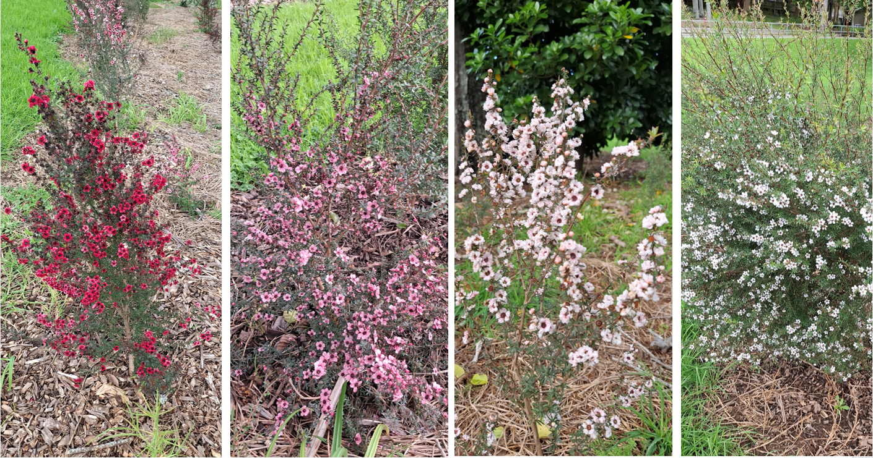




Slide 30

Galatians 6:10
As we have therefore opportunity, let us do good unto all men, especially unto then who are of the household of faith.

